Slide 1
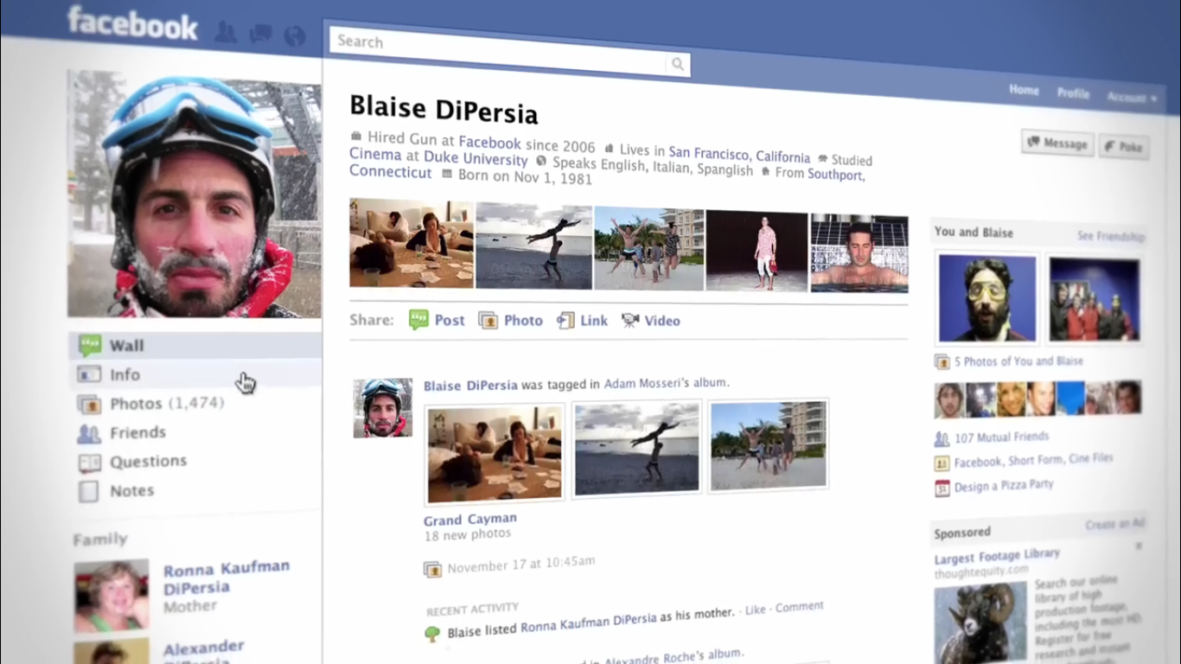
Basic 05
Meeting New People

Slide 2
Time to play and practice. Think about the question and then click to see the correct question
Questions

Slide 3
The question for email address
What´s your email address?

Slide 4
The question for name
What´s your name?

Slide 5
The question for occupation
What do you do?

Slide 6
The question for age
How old are you?

Slide 7
The question for the place he lives in
Where do you live?

Slide 8
The question for abilities
What can you do?

Slide 9
The question for activities she/he enjoys doing (entertainment activities)
What do you do for fun?

Slide 10
The question for favorite singer
Who is your favorite singer?

Slide 11
The question for personality
What are you like?

Slide 12
The question for job description
What is your job like?

Slide 13
The question for physical description
What do you look like?

Slide 14
The question for physical similarities with other people
Who do you look like?

Slide 15
The question for physical similarities with your father
Do you look like your father?

